Slide 1

STATISTICAL ANALYSIS OF HOUSEHOLD DRINKING WATER QUALITY USING R PROGRAMMING
CAPSTONE PROJECT
ITA 0406-R Programming
Presented by:
A.SabiSanthoshni Mary(192320009)
Dasari Akshitha(192320046)
B.Reshni Priya(192320035)
UNDER THE SUPERVISION OF: DR.M.AMANULLAH

Slide 2


Introduction
Drinking water quality is a critical determinant of public health and community well-being.
Water quality can vary depending on source, location, storage practices, treatment methods, and local environmental conditions.
Physical, chemical, and microbiological parameters can be measured to evaluate the quality of drinking water.
Statistical analysis helps identify variation, unusual observations, and relationships between parameters.
R programming provides a robust toolkit for data cleaning, statistical analysis, visualization, and reporting.
Possible Water-Quality Parameters
pH
Turbidity
Total Dissolved Solids (TDS)
Electrical Conductivity
Total Hardness
Chloride
Fluoride
Nitrate
Total Coliform
2

Slide 3
Aim and Objectives
AIM
To statistically analyze household drinking water quality using R programming and assess variations in selected water-quality parameters through statistical methods and data visualization.
Objectives
1
Collect and organize household drinking-water quality data.
2
Clean and preprocess the dataset using R.
3
Calculate descriptive statistics.
4
Compare water-quality parameters across sources or locations.
5
Analyze relationships between selected parameters.
6
Generate meaningful visualizations.
7
Compare measurements with selected water-quality criteria.
8
Generate a structured water-quality assessment report.
4

Slide 4
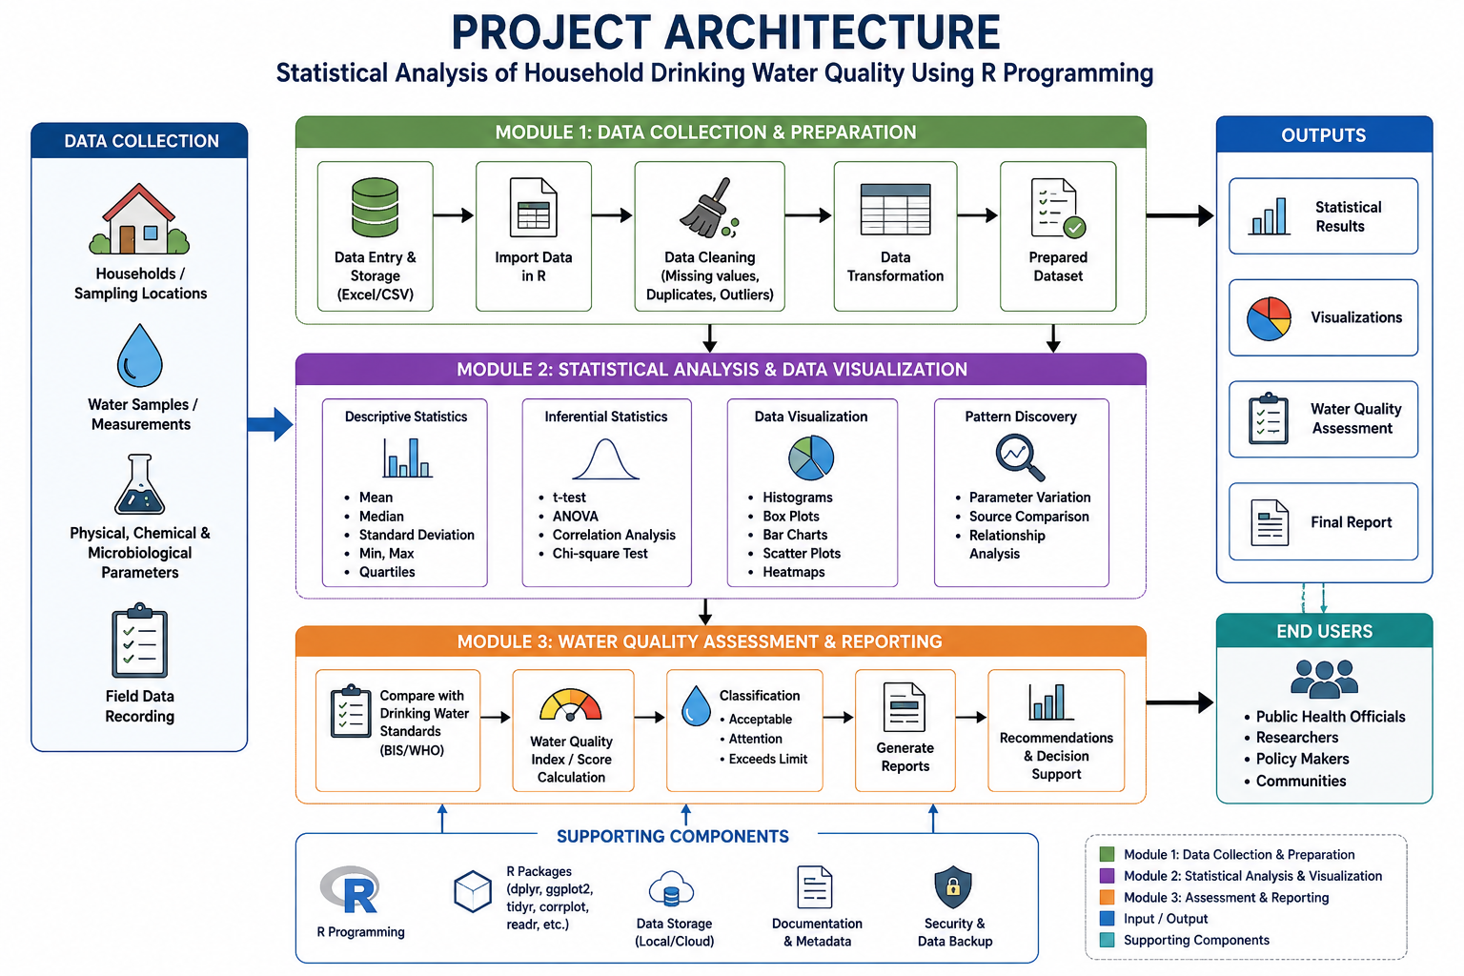
How the System Maps to SDGs
08
09
11
12
17
Decent Work &
Economic Growth
Industry, Innovation
& Infrastructure
Sustainable Cities
& Communities
Responsible
Consumption
Partnerships
for the Goals
Routes tourist spend to local guides, artisans & small heritage-town businesses.
Digitises rail booking and tourism discovery on one resilient platform.
Eases congestion by shifting short-haul travel from road/air to rail.
Carbon-comparison dashboard nudges travellers toward lower-impact trips.
Integrates with tourism boards & heritage authorities for verified data.
5

Slide 5





MODULE 1
Data Collection and Preparation: Purpose and Process
Module 1 Workflow
Module 1 forms the foundation of the entire project. Before any statistical analysis can be performed in R, household drinking-water data must first be identified, recorded, and organized into a structured, machine-readable format.
This module covers the full journey of the data — from the household or sampling location where a measurement is taken, to a clean CSV or Excel file that is ready to be imported into R for analysis.
The quality of every later result, from descriptive statistics to correlation analysis to the final water-quality assessment, depends directly on how carefully this stage is carried out.
Identify Sampling Points
Households or locations are selected and assigned unique Sample IDs.
Record Source & Context
Water source, date, and location are logged for each sample.
Measure Parameters
Selected physical, chemical, or microbiological parameters are recorded.
Store as CSV / Excel
Readings are compiled into a single structured spreadsheet.
Clean in R
The dataset is imported and cleaned before any analysis begins.
1

Slide 6
Dataset Structure and Cleaning in R
The prepared dataset is organized with one row per sample and one column per attribute, including Sample_ID, Date, Location, Water_Source, and each measured parameter such as pH, Turbidity, TDS, Electrical Conductivity, Total Hardness, Chloride, Fluoride, Nitrate, and Total Coliform.
This tabular structure allows R to treat each parameter as its own variable, which is essential for the statistical functions used later in Module 2. The final choice of parameters depends on what data is actually available and the scope agreed with the project supervisor.
Sample_ID | Date | Location | Water_Source | pH | Turbidity | TDS | EC | Hardness | Chloride | Fluoride | Nitrate | Coliform
WS-001 | 01-Jun-26 | Zone A | Borewell | 7.2 | 1.8 | 410 | 620 | 180 | 45 | 0.6 | 12 | Absent
WS-002 | 01-Jun-26 | Zone B | Municipal | 6.9 | 0.9 | 290 | 480 | 140 | 30 | 0.4 | 8 | Absent
WS-003 | 02-Jun-26 | Zone A | Storage Tank | 7.6 | 2.4 | 520 | 710 | 210 | 58 | 0.9 | 18 | Present
WS-004 | 02-Jun-26 | Zone C | Borewell | 7.0 | 1.2 | 380 | 560 | 165 | 40 | 0.5 | 10 | Absent

Slide 7
MODULE 2
Statistical Analysis and Data Visualization
Numbers alone rarely tell the full story, so Module 2 also converts statistical results into visual form using R. A histogram reveals how a single parameter, such as pH, is distributed across all samples. Box plots compare the spread and variation of a parameter across different groups, such as water sources, in a single view.
Bar charts are used to compare category-level values, scatter plots reveal the relationship between two numeric parameters, and correlation heatmaps summarize relationships across many parameters simultaneously.
Together, these visualizations make patterns, outliers, and group differences far easier to communicate than tables of numbers alone.

Slide 8
MODULE 3
Water Quality Assessment and Reporting
Parameter | Measured Value | Selected Criterion | Status
pH | 7.20 | 6.5 – 8.5 | Within Criterion
TDS (mg/L) | 410 | ≤ 500 | Within Criterion
Turbidity (NTU) | 3.10 | ≤ 1.0 | Exceeds Criterion
Hardness (mg/L) | 230 | ≤ 200 | Requires Attention
Nitrate (mg/L) | 14 | ≤ 45 | Within Criterion
Assessment should carefully consider:
Units of measurement
Sampling method used
Measurement uncertainty, where applicable
The exact standard/guideline used for comparison
R Programming Capstone Project
16

Slide 9
Limitations, Future Scope and Conclusion
LIMITATIONS
FUTURE SCOPE
CONCLUSION
Sample size may be limited.
Water quality may vary seasonally.
Measurement errors may occur.
Selected parameters may not represent every possible contaminant.
Statistical analysis does not replace certified laboratory testing.
Larger household dataset
Seasonal analysis
More microbiological parameters
Interactive R Shiny dashboard
GIS-based spatial analysis
Automated reporting
Machine-learning based prediction as an advanced extension
R programming provides a reproducible and efficient framework for collecting, preprocessing, statistically analyzing, visualizing, and assessing household drinking-water quality data.
R Programming Capstone Project
22

